Slide 1
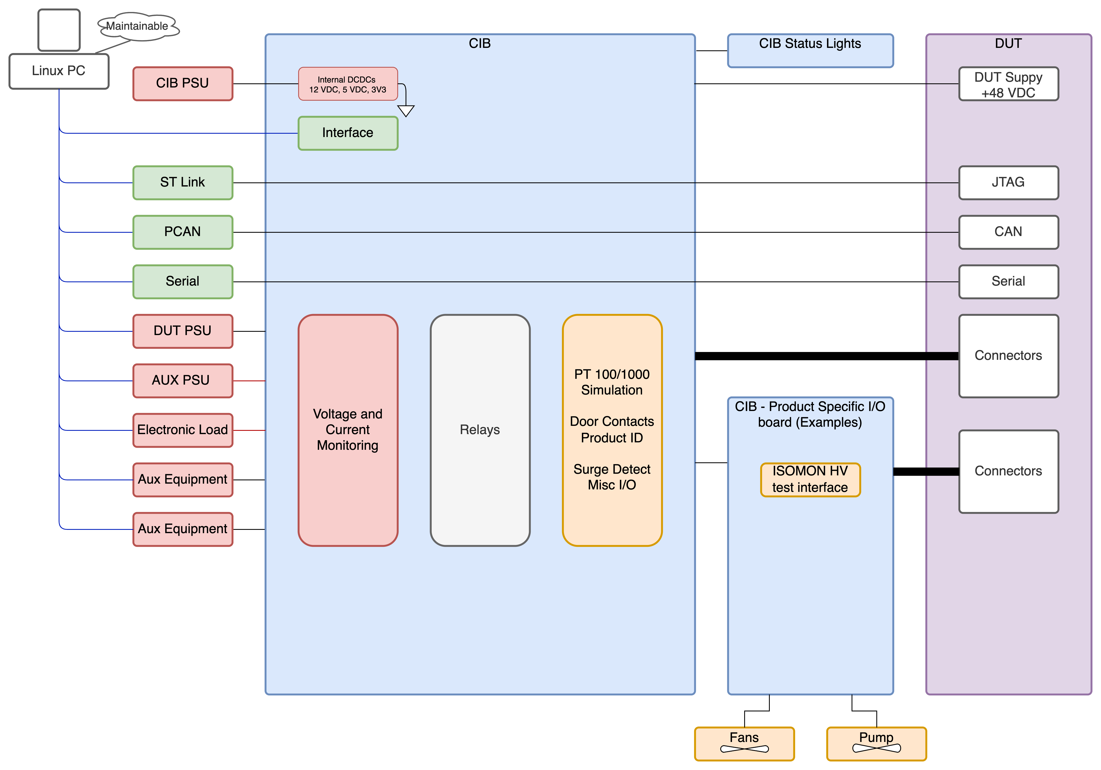
CIB (Common Interface Board)
Frank asked about a code name, at the moment I think that no one is using anything from the Cephalopod family.
The main CIB board will therefor be “Mimic Octopus”, giving plenty of space in the naming convention for product specific I/O boards etc.
Currently the CIB is designed round the requirements of the CCB, FDC 1.0 and FDC 2.0 product lines.
There is provision for support for ISOMON, and partial support for the ACB.
Further support can be built in once basic testing of the current draft is completed and the development has been shown to work with the 0.1 V hardware.
The CIB will be interfaced via SCPI commands

Slide 2
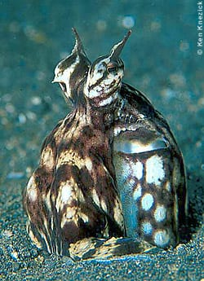
Basic I/O
2 x Pulse counter inputs (more tbc)
16 x ADC (0-5 V 10-bit successive approximation) channels
Provision for more ADC channels via mux (such as DG408)
Provision for addition ADCs
4 x 24 CPM (channel cross point matrix)
4 x 16 A, 12 x 8 A, 8 x 1A measurement channels
4 x current measurements on the CPM
4 x voltage measurements on the CPM
2 x Semi-independent DUT PSU inputs
8 x pairs of volt free contacts

Slide 3
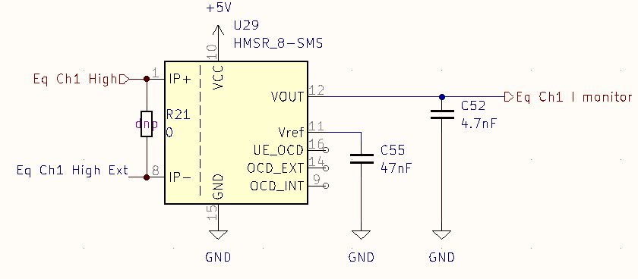
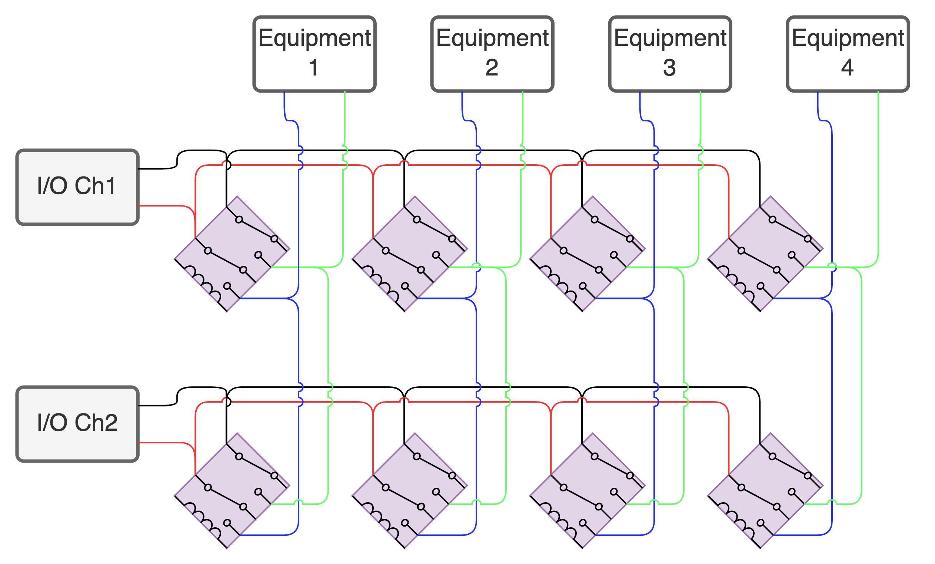
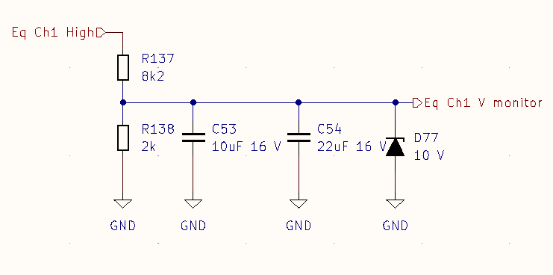
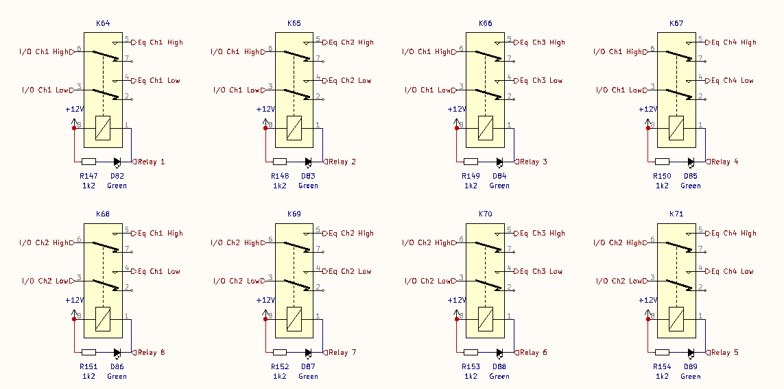
Cross Point Matrix (first two channels shown for clarity)

Slide 4
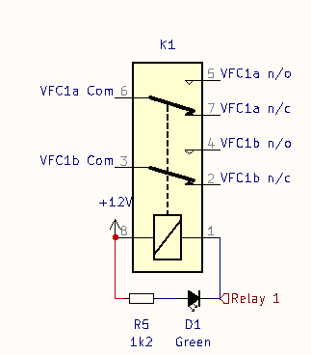
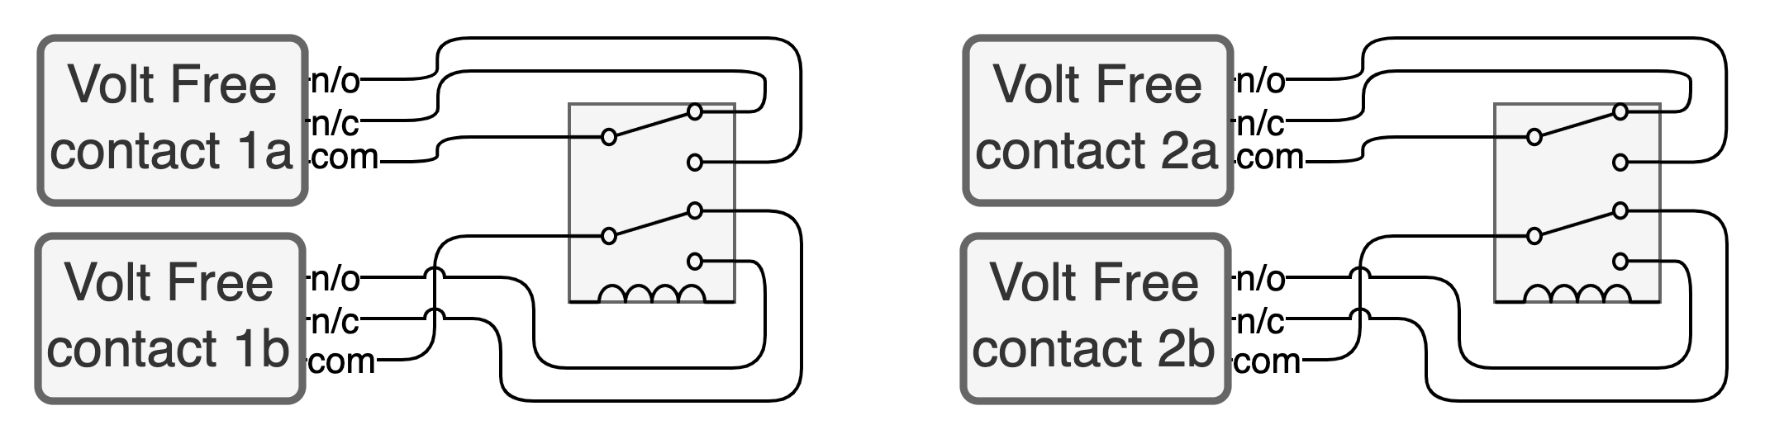
Volt Free Contacts

Slide 5
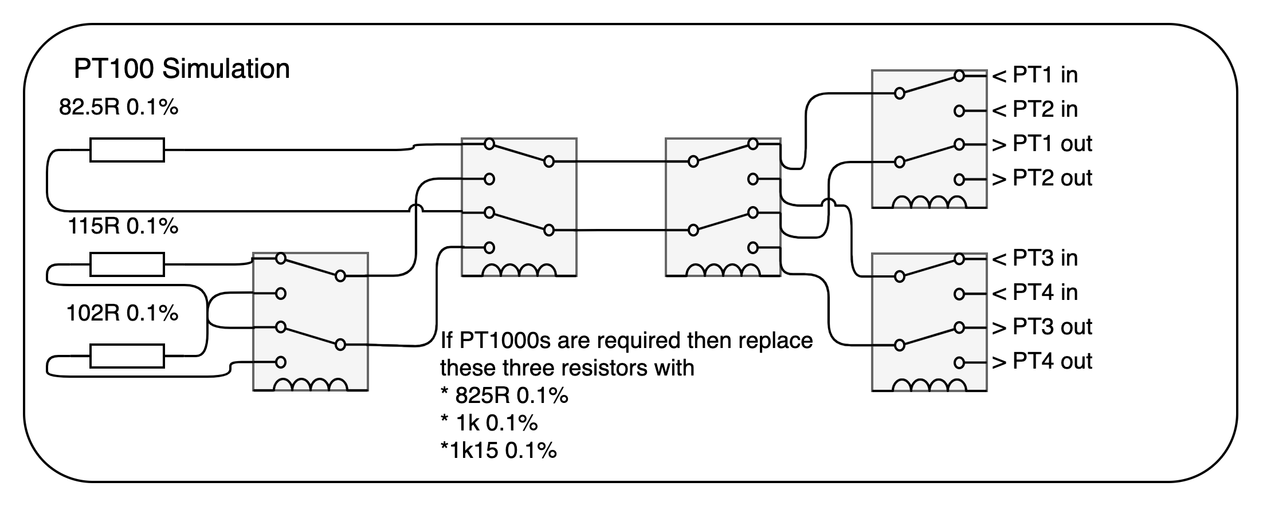
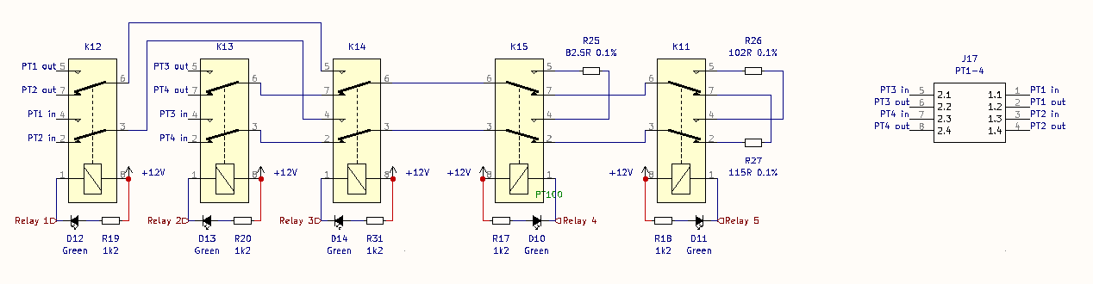
PT100 Simulation
This is based on the work of Ken Smart:
https://chargepoint.atlassian.net/wiki/spaces/EN/pages/2363396879/FDC+FCT+PVT+-+Functional+Test+Specification#RTD-Temperature-Sense-Circuits
https://chargepoint.atlassian.net/wiki/spaces/EN/pages/2707457600/FDC+FCT+PVT+-+Custom+Circuits+RTD

Slide 6
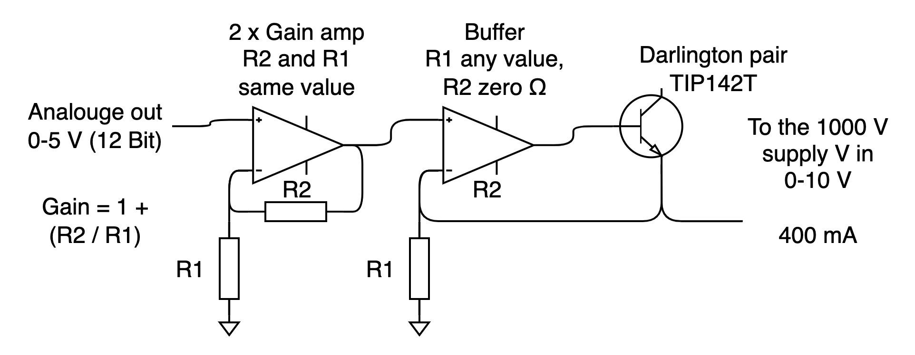
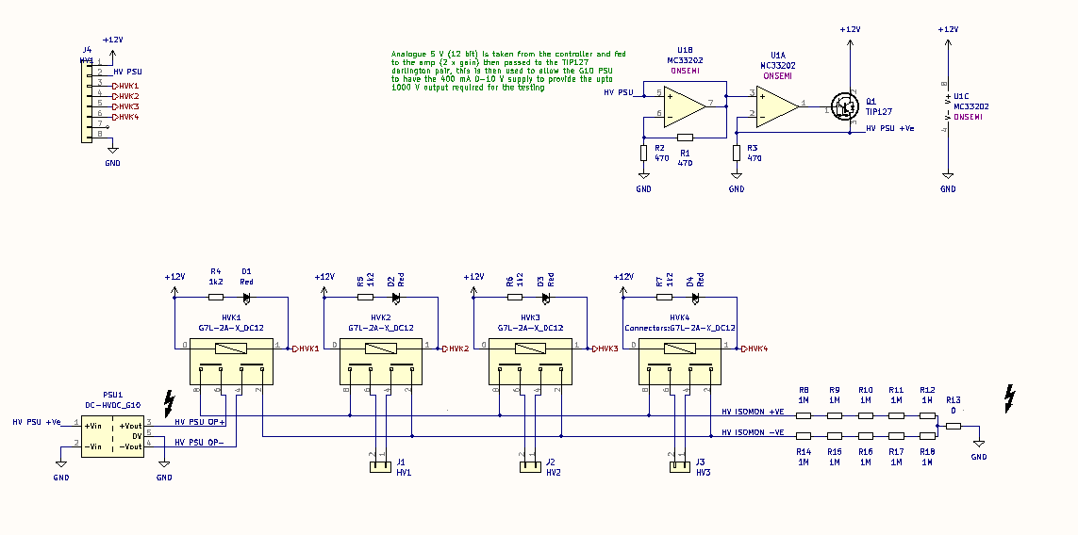
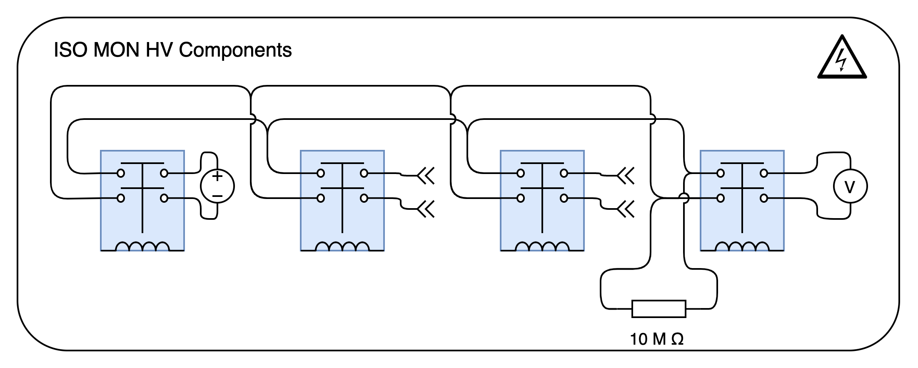
ISO MON CIB Components

Slide 7
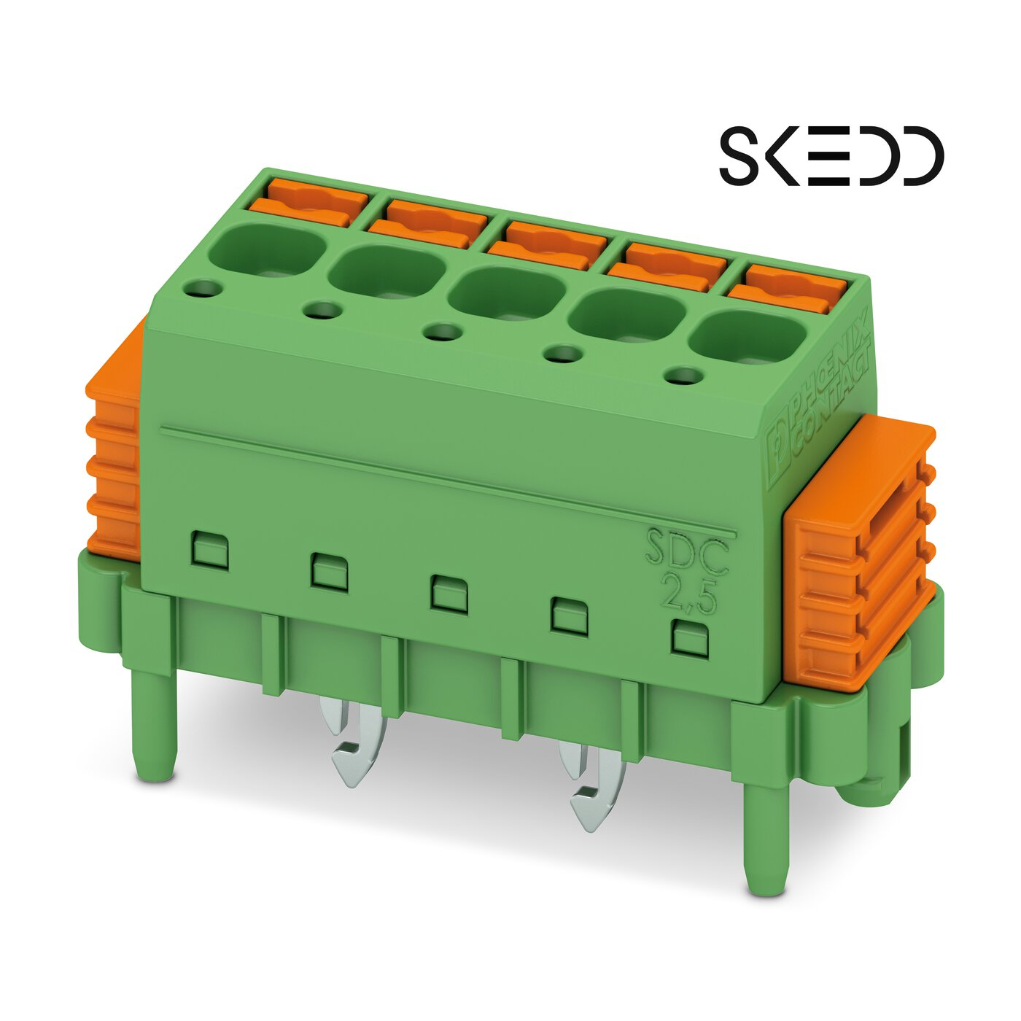
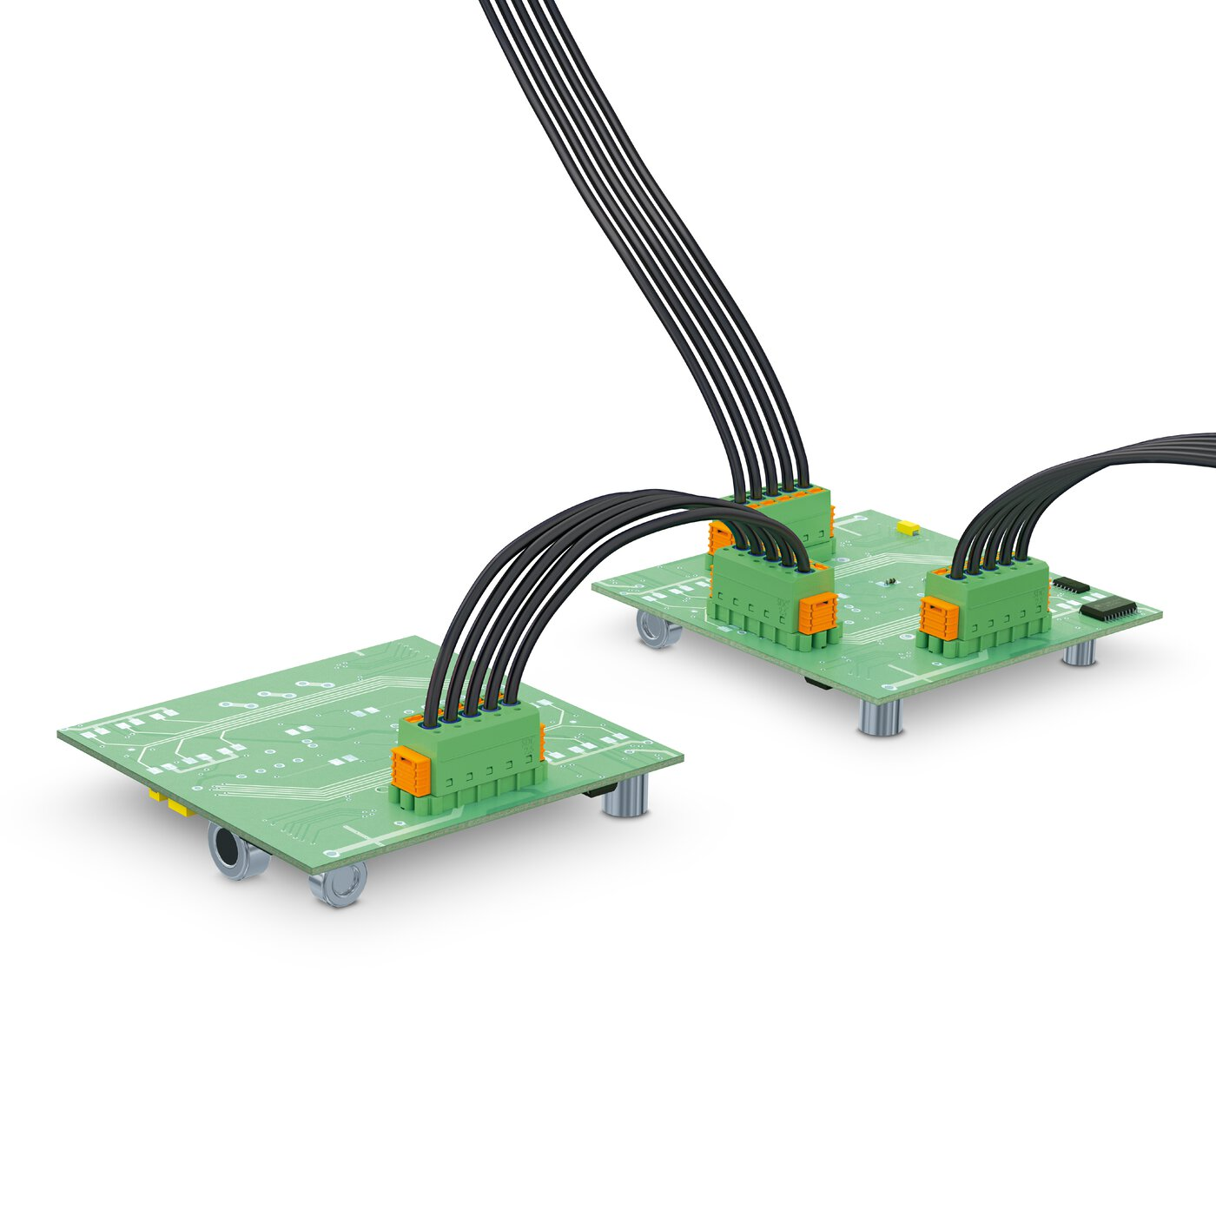
Connector Choice
Where most appropriate I have chosen to specify the Phoenix Contact SKEDD family connectors, specifically:
SDDC 1,5/{position count}-PV-3,5
SDC 2,5/{position count}-PV-5,0
These connectors are rated for 8 A and 12 A, a populated connector can be inserted into and removed from a PCB without the use of tools, the wires are retained in the connector with a spring clip (crimp version is available).

Slide 8
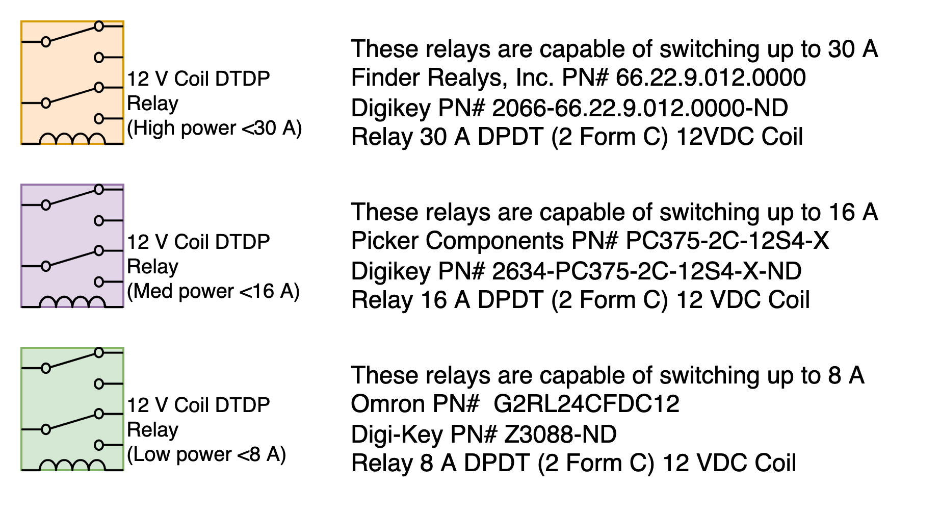
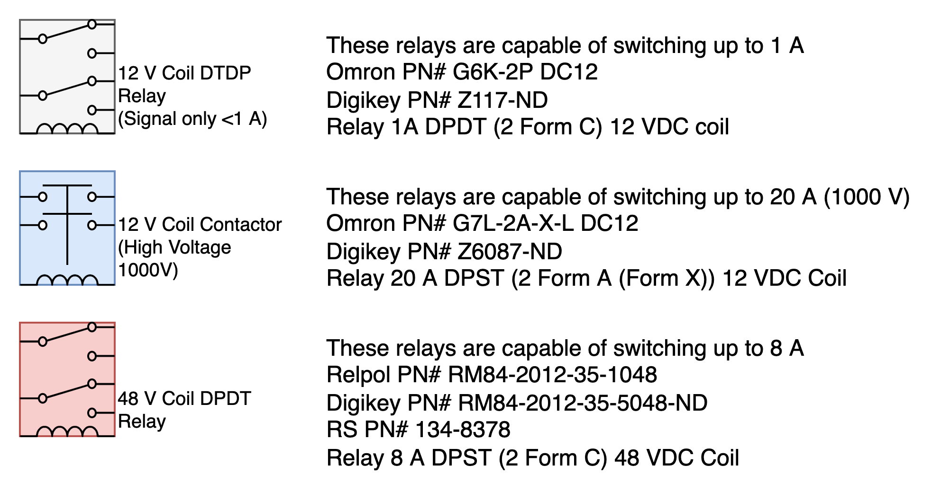
Relay Key

